Slide 1

SoEN 6441 Advanced Programming Practices Project -Winter 2024
Build 1:
Submitted by: Team 09
Jayasurya Pazhani [40289512]
Jayanth Apagundi [40291184]
Shuvanidhi Suresh [40293590]
Shahul Hameed [40290787]
Vinisha Kora Venkatesalu [40293927]
Submitted to:
Professor Joey Paquet

Slide 2
AGENDA
Code Layout
Naming Conventions
Commenting Conventions
Project Structure
Summary

Slide 3
Code Layout
Consistency: Consistent layout is maintained throughout the codebase, ensuring uniformity and making the code easier to understand and maintain.
Indentation: Proper indentation is consistently maintained throughout the codebase, ensuring clarity in the code's structure and hierarchy.
Auto-formatter: IDE auto-formatter is utilized to ensure consistent code formatting, reducing manual effort and maintaining code style consistency.
Alignment of Code Elements: Code elements, such as variable declarations and method invocations, are aligned vertically for improved readability and visual appeal.

Slide 4
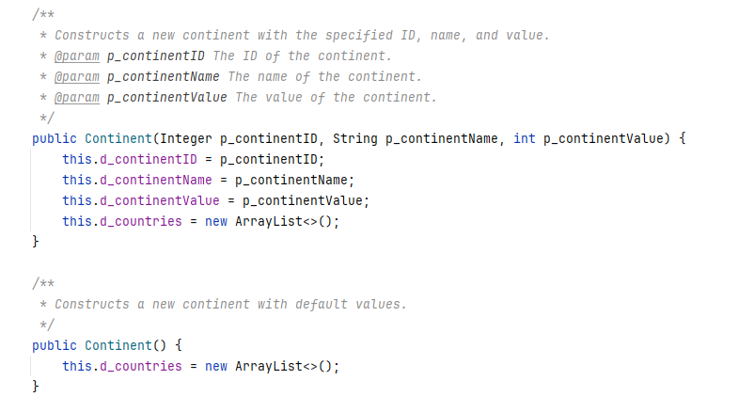
Continent.java

Slide 5
Naming Conventions
Class Names: Class names follow the CamelCase convention, starting with a capital letter (e.g., GameEngineController, Continent).
Data Members: Data members start with the 'd-' prefix, ensuring clarity and distinction from other variables (e.g., d_continentID, d_gameState).
Method Parameters: Method parameters start with the 'p-' prefix, making them easily recognizable and differentiating them from other variables (e.g., p_enteredCommand, p_args).
Static Members: Static members start with a capital letter, while non-static members start with a lowercase letter, adhering to Java conventions and ensuring consistency (e.g., d_gameState, MAPFILEEXTENSION).

Slide 6
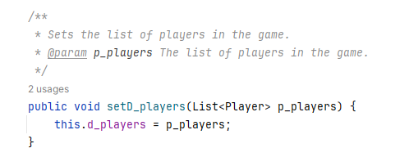
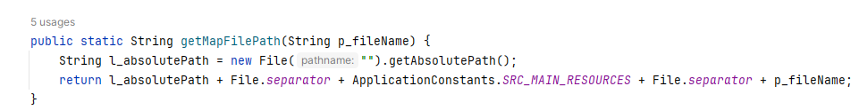
GameState.java
CommonUtil.java

Slide 7
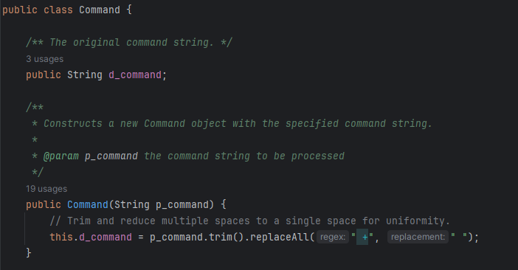
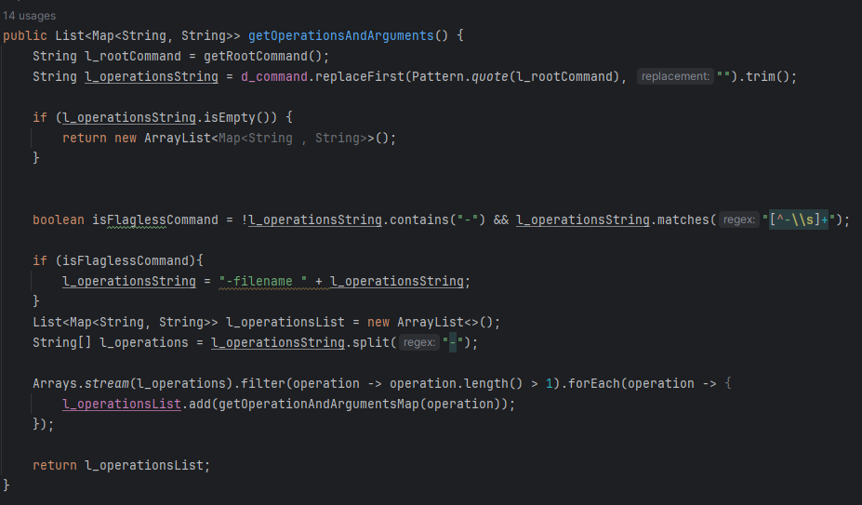
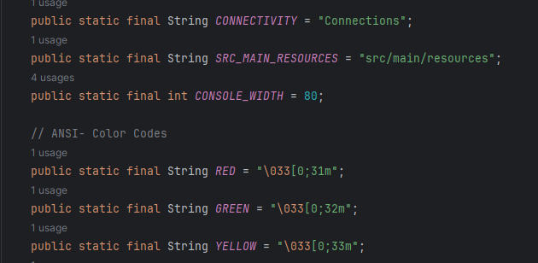
Local Variables: Local variables start with lowercase letters, enhancing readability and avoiding confusion (e.g., l_reader, l_map).
Global Variables: Global variables are in all capital letters, indicating their significance and scope (e.g., APPLICATION_CONSTANTS, COLORS).

Slide 8
Commenting Conventions
Javadoc Comments: Javadoc comments are provided for every class and method, documenting their purpose, parameters, and return values, improving code documentation and understandability.
Long Methods: Long methods (more than 10 lines) are documented with comments for procedural steps, enhancing readability and facilitating code comprehension (e.g., initGamePlay() method).
No Commented-out Code: There is no commented-out code present in the codebase, promoting cleanliness and preventing confusion or clutter.

Slide 9
Project Structure
Module Organization: One folder is created for every module in the high-level design, promoting organization and clarity in project structure.
Separate Test Folder: Tests are placed in a separate folder with the same structure as the code folder, ensuring a clear separation between production code and tests.
1-1 Relationship between Tested Classes and Test Classes: There is a 1-1 relationship between tested classes and test classes, following best practices in unit testing and ensuring comprehensive test coverage.

Slide 10
THANK YOU

